Slide 1
Financial Modeling
Time Value of Money Concepts
Jacqueline Garner, Ph.D.
Lecturer
Scheller College of Business
Present and Future Value of Lump Sums
Notes:
Hello, I’m Jacqueline Garner, and welcome to Financial Modeling

Slide 2
Before We Begin…

Slide 3
Present and Future Value of a Lump Sum
A lump sum is one cash flow at a particular point of time
Present value is the worth or value of a future cash flow
The present value can be found by discounting the future cash flow
Future value is the worth or value of a cash flow at some future date
It can be found by compounding the present value

Slide 4
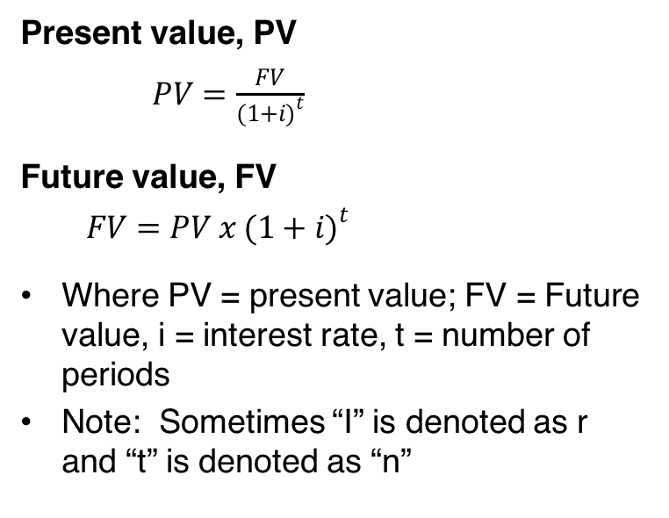
Present and Future Value Formulas
Present value, PV
$PV=\frac{FV}{{(1+i)}^{t}}$
Future value, FV
$FV=PV x {(1+i)}^{t}$
Where PV = present value; FV = Future value, i = interest rate, t = number of periods
Note: Sometimes “I” is denoted as r and “t” is denoted as “n”

Slide 5
Examples
Let’s look at some examples in the file named:
“Time_value_of_money_examples.xlsx”

Slide 6
Summary

